Slide 1
2023 Final Budget & Levy Adoption
December 6th 2022

Slide 2
Public Input / Discussion
The Minnesota Department of Revenue provides the following guidance regarding tonight’s meeting:
Final Levy cannot exceed Preliminary Levy
State Statute 275.065 Subd. 6. - Adoption of budget and levy. (a) The property tax levy certified under section 275.07 by a city of any population, county, metropolitan special taxing district, regional library district, or school district must not exceed the proposed levy determined under subdivision 1
Discuss budget and proposed property tax
The proposed property tax levy for the taxes payable year 2022 and the proposed budget for the taxes payable year 2022, must be discussed at the public meeting.
Public comment and questions
The public must be given a reasonable amount of time to comment on the proposed property tax levy and budget and to ask questions. Robert’s Rules of Order may be used to govern the conduct of the meeting.

Slide 3
Fiscal Management
Manage Components of Municipal Budget
Consider Associated Timelines
Small & Steady Increases/Decreases in Levy/Tax Rate Over Time

Slide 4
Components of Municipal Budget
Category | Revenue | Expense | Competency
Operating Rev/Exp | GF Levy / Rates | 3-5 yr Avg., 6m Actual | All - Easy But Not Assured
Intergovernmental Rev/Exp | LGA / Grants | Regulations / Legislation | All - Legal Requirement
Capital Projects | Levy / Rates | 10-20 year Horizon | Most - $ to Engineer
Capital Maint./Replacement | Levy / Rates | 20 year Horizon | Few - Difficult **
** Largest Available Marginal Competitive Advantage

Slide 5
Property Tax Calculation
Why Tax Rate Is More Important Than Levy Amount
Levy Will Always Go Up Over Time
Tax Rate Provides Better Comparison Between Cities And Years
Tax Rate = Levy / Tax Capacity (Adjusted Market Value)
Property Value X Tax Rate = Property Taxes
Property owners can appeal the assessed value of their property at the annual Local (April) or County (June) Board of Equalization Meeting. Appeals affect the coming tax year, not current tax year.

Slide 6
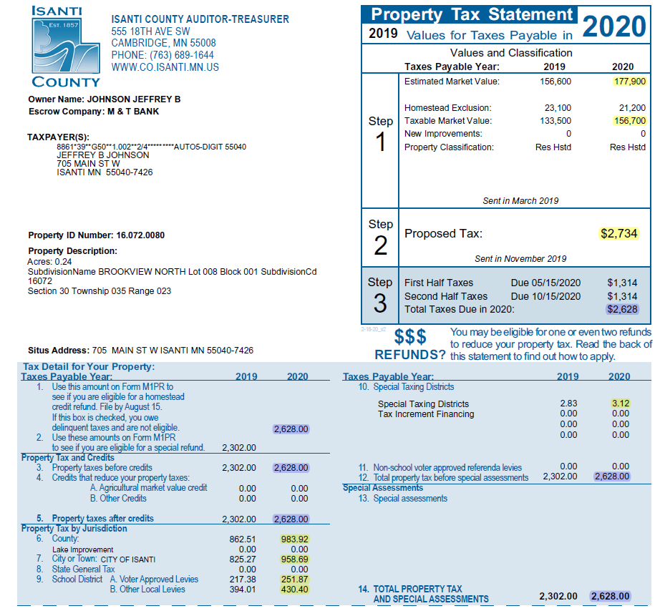
Value Determined by County Assessor, 90-105% of Fair Market Value by Statute
TMV=EMV Less Exclusions
Total Amount Originally Proposed
by Taxing Jurisdictions (September)
Total Amount After Final Adoption
By Taxing Jurisdictions (December)
10. East Central Regional
Development Commission
6. County Tax Amount
7. City Tax Amount
9.A/B. School District Tax Amount

Slide 7
Budget Options to Consider
Delaying Street Improvement Projects
  All current projects were originally identified in 2010
Delay / Eliminate Capital Maint/Replacement Items
  All items have been identified as needed
Reduce Operating Expenditures
  Contracts and other legal obligations limit scope of possible cuts

Slide 8
Budget Summary
Title / Detail | 2023 PROPOSED | 2022 BUDGET | 2021 BUDGET | 2021 ACTUAL | 2020 ACTUAL | 2019 ACTUAL
TAXES | 2,910,412 | 2,187,663 | 1,918,132 | 1,878,203 | 1,859,747 | 1,844,384
LICENSES/PERMITS | 285,525 | 388,500 | 350,800 | 351,751 | 448,614 | 348,118
INTERGOVERNMENTAL | 1,019,918 | 1,003,593 | 1,008,198 | 1,017,502 | 1,288,115 | 789,776
CHARGES FOR SERVICES | 165,425 | 199,400 | 203,475 | 179,380 | 129,488 | 230,468
FINES AND FORFEITURES | 35,800 | 38,850 | 53,050 | 33,284 | 32,756 | 52,502
MISCELLANEOUS | 37,850 | 51,400 | 35,850 | 25,662 | 68,470 | 74,537
TRANSFERS IN | 372,605 | 360,481 | 486,400 | 486,400 | 451,176 | 369,150
GENERAL FUND REVENUES | 4,827,535 | 4,274,890 | 4,018,487 | 3,972,182 | 4,278,366 | 3,708,935
COUNCIL | 44,550 | 40,064 | 38,719 | 35,679 | 40,038 | 36,025
FINANCIAL ADMINISTRATION | 633,356 | 592,270 | 561,411 | 541,295 | 515,328 | 490,416
PLANNING AND ZONING | 167,875 | 160,478 | 150,093 | 138,485 | 133,373 | 86,632
MUNICIPAL BUILDING | 50,835 | 38,140 | 39,654 | 49,593 | 38,153 | 54,234
POLICE ADMINISTRATION | 2,021,860 | 1,863,451 | 1,743,607 | 1,683,863 | 1,411,553 | 1,397,350
FIRE PROTECTION | 304,300 | 273,600 | 257,990 | 253,972 | 244,229 | 234,663
BUILDING INSPECTION ADMIN | 295,890 | 278,382 | 192,707 | 223,386 | 398,040 | 351,585
CIVIL DEFENSE | 2,470 | 2,140 | 2,140 | 2,140 | 2,140 | 4,280
ANIMAL CONTROL | 3,110 | 3,095 | 3,091 | 3,000 | 3,071 | 1,568
GENERAL CITY MAINTENANCE | 68,080 | 60,995 | 58,436 | 53,649 | 45,824 | 43,426
HWYS, STREETS, & ROADS | 461,360 | 424,054 | 382,949 | 329,138 | 344,865 | 395,418
STREET LIGHTING | 56,100 | 53,500 | 51,130 | 58,434 | 53,811 | 48,239
SANITATION ADMINISTRATION | 31,800 | 26,450 | 24,875 | 23,633 | 23,023 | 17,060
PARK,REC,CULTURE | 453,485 | 406,920 | 371,307 | 338,477 | 333,074 | 319,906
TRANSFERS | 50,825 | 25,765 | 28,944 | - | - | 152,284
MISCELLANEOUS | 15,460 | 14,885 | 13,852 | 14,986 | 363,183 | 124,229
GENERAL FUND EXPENDITURES | 4,661,356 | 4,274,889 | 3,933,488 | 3,762,902 | 4,027,252 | 4,008,386
NET INCOME / (LOSS) | 166,179 | 1 | 84,999 | 209,280 | 251,114 | (299,451)

Slide 9
Budget Summary
Title / Detail | 2023 PROPOSED | 2022 BUDGET | 2021 BUDGET | 2021 ACTUAL | 2020 ACTUAL | 2019 ACTUAL
EDA REVENUES | 134,175 | 111,448 | 100,017 | 105,402 | 101,322 | 186,485
EDA EXPENDITURES | 134,175 | 109,351 | 225,018 | 228,985 | 108,227 | 71,225
NET INCOME / (LOSS) | - | 2,097 | (125,001) | (123,583) | (6,905) | 115,261
STREET CONSTRUCTION REVENUES | 707,100 | 402,150 | 1,358,800 | 489,725 | 163,092 | -
STREET CONSTRUCTION EXPENDITURES | 400,000 | 657,000 | 1,215,500 | 753,022 | 675,253 | 15,328
NET INCOME / (LOSS) | 307,100 | (254,850) | 143,300 | (263,297) | (512,162) | (15,328)
PAVEMENT MANAGEMENT REVENUES | 342,495 | 336,269 | 322,778 | 332,803 | 319,735 | 318,440
PAVEMENT MANAGEMENT EXPENDITURES | 285,825 | 323,750 | 316,000 | 294,998 | 292,477 | 251,533
NET INCOME / (LOSS) | 56,670 | 12,519 | 6,778 | 37,805 | 27,258 | 66,906
WATER FUND REVENUES | 1,675,500 | 1,765,464 | 1,546,809 | 1,758,946 | 2,227,497 | 1,392,456
WATER FUND EXPENDITURES | 2,733,126 | 2,186,820 | 1,967,826 | 1,084,429 | 1,003,294 | 1,337,527
NET INCOME / (LOSS) | (1,057,626) | (421,356) | (421,017) | 674,516 | 1,224,203 | 54,929
SEWER FUND REVENUES | 1,740,000 | 2,040,159 | 1,928,939 | 1,885,243 | 2,467,919 | 1,907,470
SEWER FUND EXPENDITURES | 2,002,844 | 2,296,896 | 1,896,089 | 1,472,253 | 1,398,612 | 1,605,614
NET INCOME / (LOSS) | (262,844) | (256,737) | 32,850 | 412,990 | 1,069,307 | 301,856
STORM WATER FUND REVENUES | 310,300 | 404,800 | 386,150 | 392,528 | 375,320 | 362,392
STORM WATER FUND EXPENDITURES | 251,091 | 213,668 | 456,684 | 210,842 | 154,339 | 169,345
NET INCOME / (LOSS) | 59,209 | 191,132 | (70,534) | 181,686 | 220,980 | 193,047
MUNICIPAL LIQUOR FUND REVENUES | 5,143,265 | 4,386,054 | 3,213,605 | 4,161,010 | 3,985,132 | 3,120,004
MUNICIPAL LIQUOR FUND EXPENDITURES | 5,226,210 | 4,405,728 | 3,244,518 | 4,550,405 | 3,808,655 | 3,174,635
NET INCOME / (LOSS) | (82,945) | (19,674) | (30,913) | (389,394) | 176,477 | (54,631)
CITY TECHNOLOGY REVENUES | 27,000 | 28,190 | 27,910 | 26,370 | 26,264 | 13,557
CITY TECHNOLOGY EXPENDITURES | 20,473 | 24,479 | 22,695 | 24,375 | 23,122 | 13,816
NET INCOME / (LOSS) | 6,527 | 3,711 | 5,215 | 1,995 | 3,143 | (258)
CAPITAL IMPROVEMENT REVENUES | 843,417 | 700,056 | 567,900 | 848,233 | 286,436 | 547,688
CAPITAL IMPROVEMENT EXPENDITURES | 794,608 | 431,236 | 627,990 | 1,937,321 | 281,370 | 268,651
NET INCOME / (LOSS) | 48,809 | 268,820 | (60,090) | (1,089,087) | 5,066 | 279,037

Slide 10
Fiscal Management
Small & Steady Increases/Decreases in Levy/Tax Rate Over Time
Manage Components of Municipal Budget
  Operating Rev/Exp
    Staffing, PRC Programming, Road Maint., Snow Removal, Police Presence/Patrols, Fire Protection
    Capital Projects
      Identify and fund on consistent annual basis. Expenditures will vary annually but revenue collection should be consistent and predictable
      2028 is scheduled for 1.37 million in expenses. 2028 levy for street projects expected to be 373k.
      Avoid issuing bonds (debt) whenever possible. Borrowing 1 million costs roughly 250k in interest and issuance costs, at the lowest historical Muni rates. Currently the cost is closer to 400k.
      Capital Maintenance/Replacement
        Identify and fund on consistent annual basis. Expenditures will vary annually but revenue collection should be consistent and predictable
        2025 is scheduled for 2.81 million in expenses. 2025 levy for Capital Maint/Replacement is expected to be 494k
        20-year plan should include ALL maintenance and replacement items. From squad cars and plow trucks to tuck pointing brickwork.
        Review annually and only replace when needed. If equipment performs beyond expected useful life, move scheduled expense to following year and reevaluate.

Slide 11
Considerations in Setting Levy
Capital Project Funding
  Next 7 years of street projects identified in 2010 to begin in 2012
  Capital Maintenance/Replacement Funding
    20-year cash flow analysis is presented, 35-40 years is monitored.
    Fund Balance – General Fund
      26k annual repayment to Liquor Fund for 2018 Improvements, 10 year repayment ends in 2029 budget year

Slide 12
Proposed Levy
LEVY | 2022 | 2023
GENERAL FUND LEVY (101) | $ 2,150,000 | $ 2,875,000
CAPITAL MAINT. LEVY (920) | $ 451,900 | $ 465,500
STREET CONST. LEVY (425) | $ 295,000 | $ 307,000
EDA LEVY (108) | $ 98,038 | $ 122,375
ABATEMENT LEVY (101) | $ 13,763 | $ 14,112
DEBT SERVICE LEVY | $ 273,150 | $ 258,967
930 - 2011A GO BOND | $ -0- | $ 9,367
931 - 2014A TAX ABATEMENT | $ 223,821 | $ 210,630
932 - 2014B GO BOND | $ 49,329 | $ 48,337
TOTAL LEVY | $ 3,281,851 | $ 4,042,954

Slide 13
Levy History

Slide 14
Levy or Tax Rate?

Slide 15
ACTUAL 2022 DATA
CITY A | CITY B
152K LEVY | 8.6M LEVY

Slide 16
ACTUAL 2022 DATA
CITY A | CITY B
152K LEVY | 8.6M LEVY
297.8% TAX RATE | 34.5% TAX RATE

Slide 17
ACTUAL 2022 DATA
CITY A | CITY B
152K LEVY | 8.6M LEVY
297.8% TAX RATE | 34.5% TAX RATE
79K MARKET VALUE | 350K MARKET VALUE

Slide 18
ACTUAL 2022 DATA
CITY A | CITY B
152K LEVY | 8.6M LEVY
297.8% TAX RATE | 34.5% TAX RATE
79K MARKET VALUE | 350K MARKET VALUE

Slide 19
ACTUAL 2022 DATA
CITY A | CITY B
152K LEVY | 8.6M LEVY
297.8% TAX RATE | 34.5% TAX RATE
79K MARKET VALUE | 350K MARKET VALUE
 | 2022 CITY TAX $1,193

Slide 20
ACTUAL 2022 DATA
CITY A | CITY B
152K LEVY | 8.6M LEVY
297.8% TAX RATE | 34.5% TAX RATE
79K MARKET VALUE | 350K MARKET VALUE
2022 CITY TAX $1,465 | 2022 CITY TAX $1,193

Slide 21
Proposed Tax Rate

Slide 22
Tax Rate History

Slide 23
Levy / Tax Rate History

Slide 24
Competitive Metric
 | TAX RATES
CITY | 2018 | 2019 | 2020 | 2021 | 2022 | NET CHANGE
OTSEGO | 36.556 | 36.060 | 35.099 | 34.653 | 34.545 | -5.50%
EAST BETHEL | 44.510 | 43.204 | 41.467 | 38.348 | 37.391 | -15.99%
LINO LAKES | 42.825 | 41.816 | 39.869 | 40.109 | 40.154 | -6.24%
RAMSEY | 41.727 | 40.353 | 39.592 | 39.251 | 42.239 | 1.23%
ZIMMERMAN | 45.656 | 44.578 | 41.239 | 41.624 | 42.697 | -6.48%
ELK RIVER | 46.011 | 45.907 | 46.241 | 44.556 | 43.967 | -4.44%
NORTH BRANCH | 52.982 | 49.466 | 47.411 | 45.072 | 44.097 | -16.77%
ST. FRANCIS | 53.996 | 53.175 | 50.542 | 50.589 | 51.147 | -5.28%
ISANTI | 79.599 | 61.818 | 61.180 | 60.375 | 59.012 | -25.86%
PRINCETON | 71.907 | 69.782 | 66.565 | 61.617 | 63.980 | -11.02%
CAMBRIDGE | 81.252 | 76.653 | 75.052 | 73.203 | 70.182 | -13.62%
BRAHAM | 84.841 | 84.391 | 76.354 | 77.329 | 79.722 | -6.03%

